Slide 1

Queute
Mohamed Belhadj Lakhel
Ruqaia Sabta
Aymen Kamoun
Mohamed Ouerfelli
Melek Guirat
Rabii Cheffi
Mohamed Naceur Khlifi
Because every minute counts.

Slide 2
Introduction
Mohamed Belhadj Lakhel
Ruqaia Sabta
Aymen Kamoun
Mohamed Ouerfelli
Melek Guirat
Rabii Cheffi
Mohamed Naceur Khlifi

Slide 3
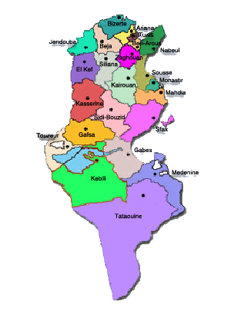
Introduction
Mohamed Belhadj Lakhel
Ruqaia Sabta
Aymen Kamoun
Mohamed Ouerfelli
Melek Guirat
Rabii Cheffi
Mohamed Naceur Khlifi

Slide 4

Introduction
This is Ali

Slide 5
Ali is a University student
This is Ali

Slide 6
And he wants to apply for an exchange
Semester program
This is Ali
Ali is a University student

Slide 7
He needs a passport
This is Ali
And he wants to apply for an exchange
Semester program
Ali is a University student

Slide 8
After a tiring research he gathered the papers
Needed and went to police station
To get his passport
He needs a passport
And he wants to apply for an exchange
Semester program

Slide 9
But turned out after waiting in line
Some time that some
papers are missing
After a tiring research he gathered the papers
Needed and went to police station
To get his passport
He needs a passport

Slide 10
This is Ali
But turned out after waiting in line
Some time that some
papers are missing
Ali sacrificed a lot of precious time waiting but his efforts
Weren’t met with success
After a tiring research he gathered the papers
Needed and went to police station
To get his passport

Slide 11

this is Yassine
Ali sacrificed a lot of precious time waiting but his efforts
Weren’t met with success
But turned out after waiting in line
Some time that some
papers are missing

Slide 12
this is Yassine
Ali sacrificed a lot of precious time waiting but his efforts
Weren’t met with success

Slide 13
Yassine used Queute, he checked
the roadmap to get the passport
And didn’t encounter any problems

Slide 14
Dont be like Ali, Be like Yassine.

Slide 15
Problem statement

Slide 16

Bureaucracy is stressful

Slide 17
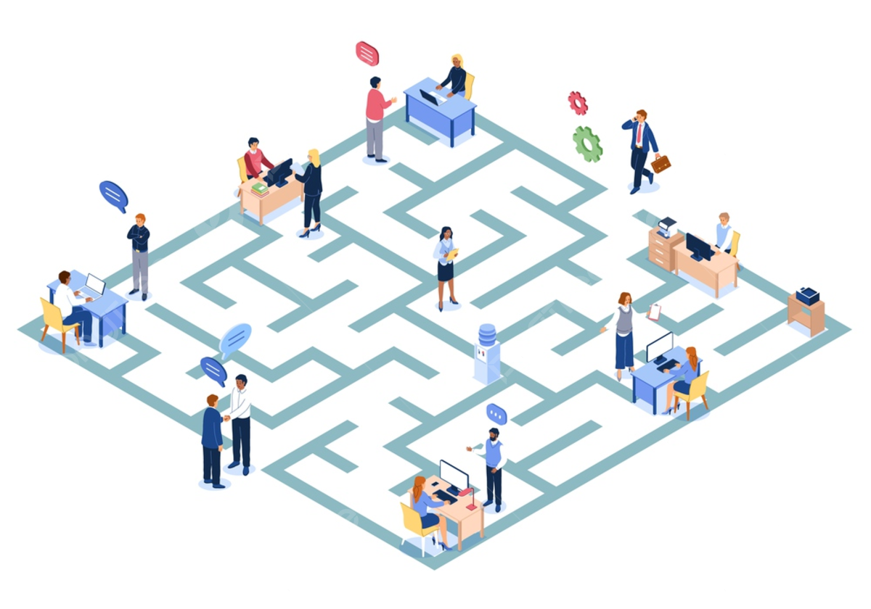
Procedures are confusing and complicated

Slide 18

Endless queues

Slide 19

Internet Failures And low disponibilty

Slide 20
Solution

Slide 21
How it works

Slide 22







Slide 23
Smart Reservations

Slide 24
Services Ratings

Slide 25
Services Roadmap
And
Progression tracking

Slide 26
Real-time Chatting
&
AI Assistance

Slide 27
Virtual Meetings
&
Document uploads

Slide 28
Location Based
Optimizations

Slide 29
Why it works
Location Based
Optimizations

Slide 30




Slide 31
Time Efficiency

Slide 32
Enhanced customer
Experience

Slide 33
Data-driven
optimizations

Slide 34
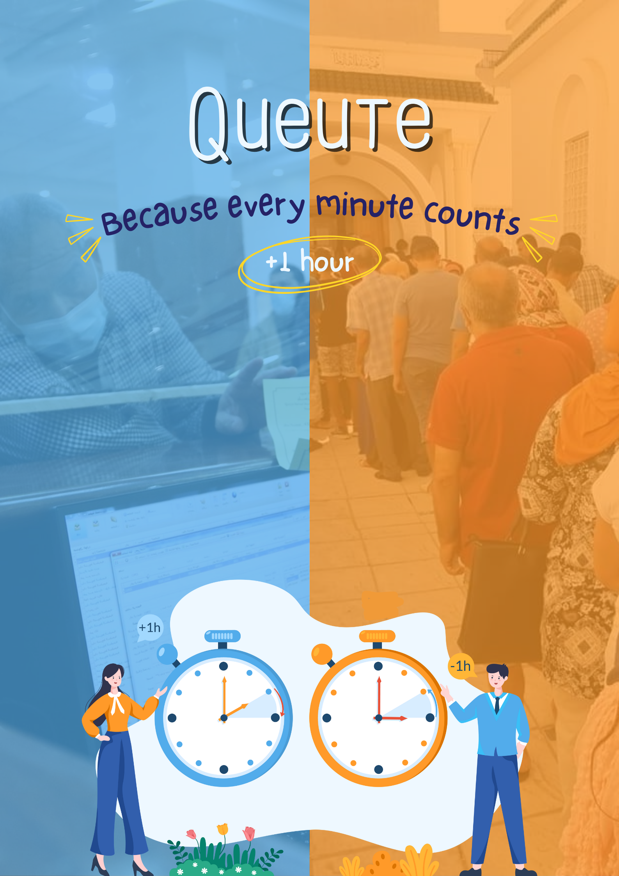
Queute
Poster
Data-driven
optimizations

Slide 35
Features and benefits
Data-driven
optimizations

Slide 36

Users and organizations
Can sign up

Slide 37

Organizations
Register the services
Offered to users

Slide 38
Roadmaps
Offered to users
To track the progress of the papers or services
They need

Slide 39

Forum for users
To discuss service related topics and issues

Slide 40

Workspaces for employees to work more efficienty offering collaborative tools
Like meet, chat..

Slide 41

Users can reserve queue tickets for the desired services

Slide 42
Benefits

Slide 43


Benefits
Better decision making
Time efficiency

Slide 44
Market Analysis

Slide 45


Market Analysis
Target Audience
Market Demand
17 and above
Very high

Slide 46
Existing solutions
Biat Rendez-vous
TSB

Slide 47
Locally
Biat Rendez-vous
TSB

Slide 48
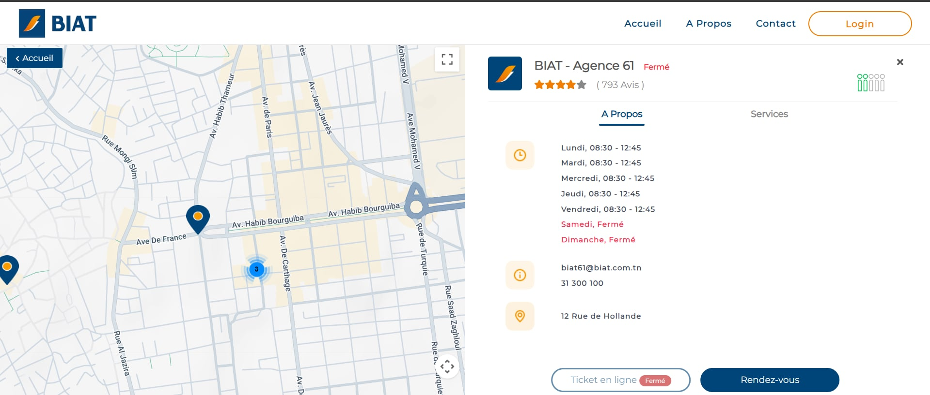
Locally
TSB
Biat Rendez-vous
BIAT Bank offers an online appointment scheduling service called "MonRDV BIAT" to help you avoid waiting in line at their branches

Slide 49
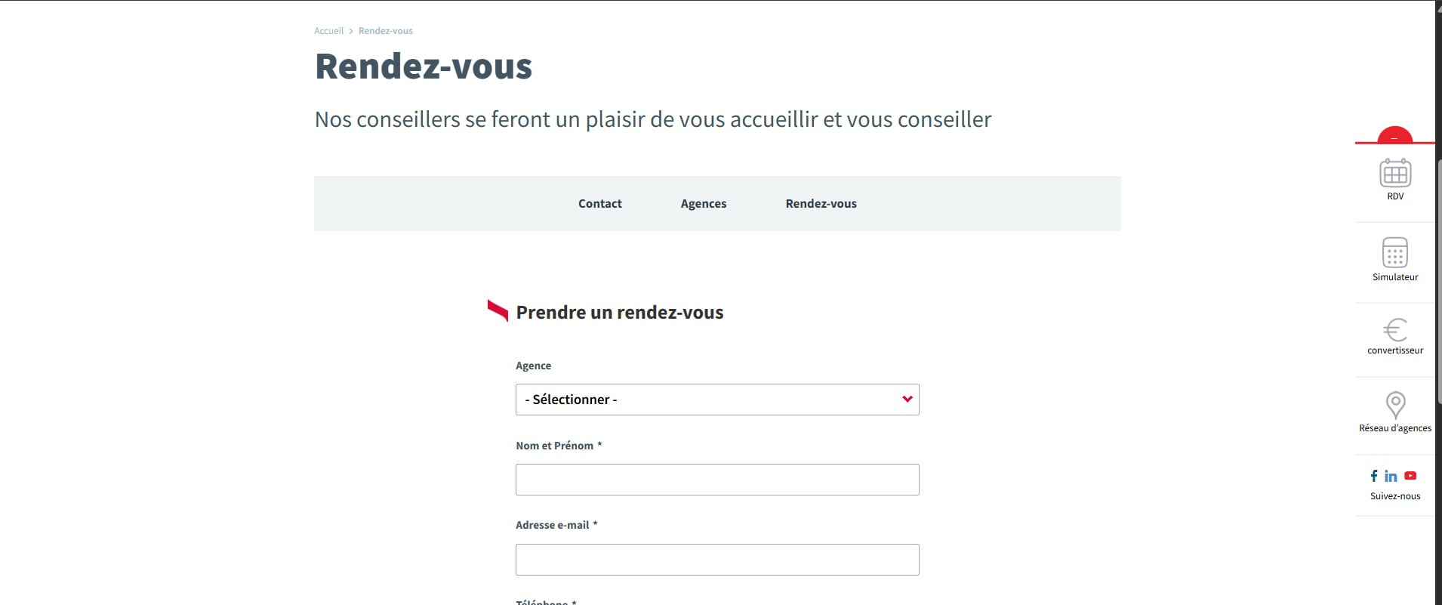
Locally
TSB
TSB RDV is an appointment scheduling application designed for TSB Bank customers. It allows users to book, manage, and track appointments with bank representatives
Biat Rendez-vous

Slide 50
Internationally
Simply book
Smart agenda

Slide 51
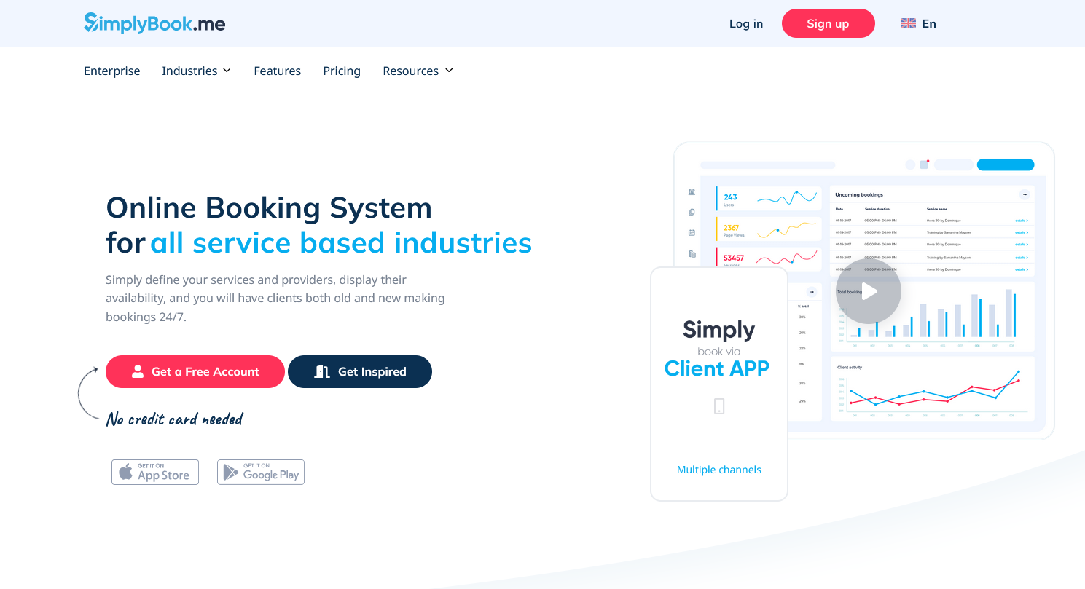
Locally
Smart agenda
solution for managing your appointments online
TSB
Simply book
Online Booking System for all service based industries

Slide 52
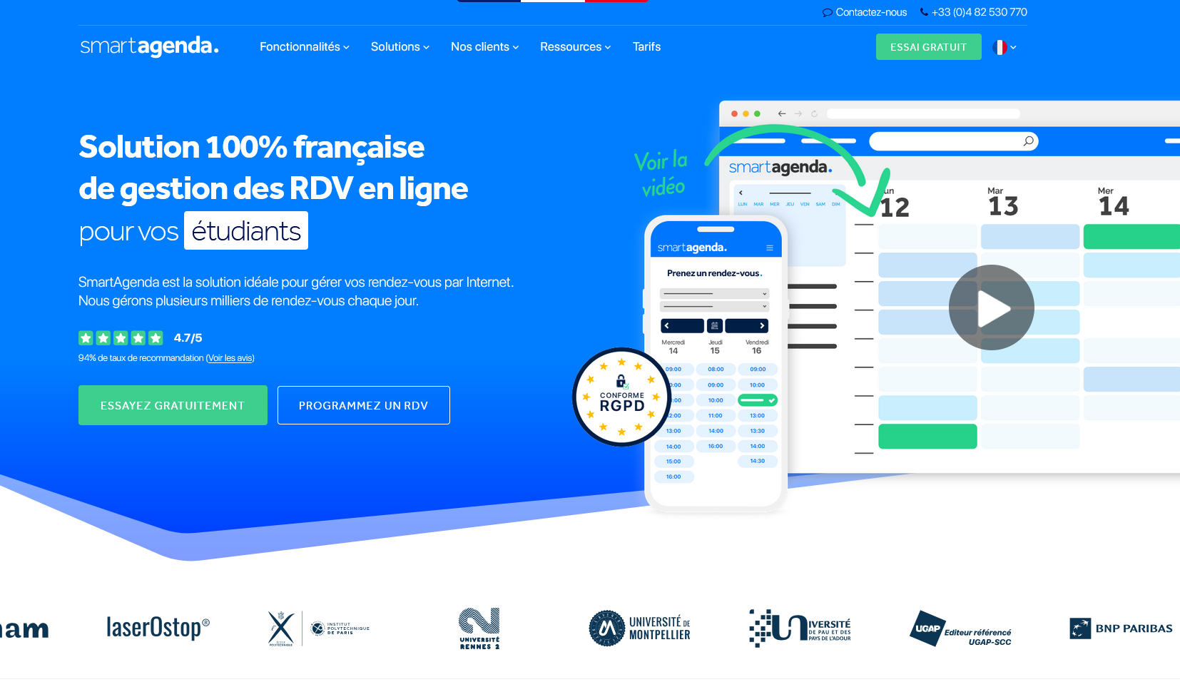
Locally
Smart agenda
solution for managing your appointments online
Simply book
Online Booking System for all service based industries
Biat Rendez-vous

Slide 53
Implementation Plan

Slide 54
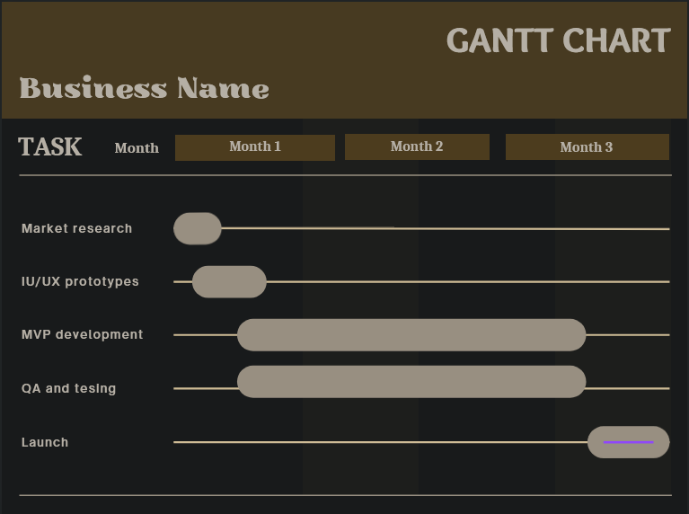
Product development and timeline
: Queute

Slide 55



Fullstack development
Required resources
database
Infrastructure

Slide 56
Slow Adaptation
Risk and solution
High
infrastructure
cost
Security and privacy
Free trial
Cloud optimization
Robust Encyption
system

Slide 57



Conclusion
SDGs

Slide 58
SDGs

Slide 59
Thanks for your attention

